Slide 1
Quality of Student Mobilities
“If there is no struggle, there is no progress…”
Zdeňka Hort & Michaela Menšíková

Slide 2
Audience Q&A Session
ⓘ Start presenting to display the audience questions on this slide.
Notes:
📣 This is Slido interaction slide, please don't delete it. ✅ Click on 'Present with Slido' and the questions from your audience will appear when you get to this slide.

Slide 3
Student life on mobility has not changed much during pandemic?
Or has it?

Slide 4
My everyday life in a pandemic - our outgoing student
I start my day with my routine. Fast warm-up, shower, breakfast. Than I run for a bus, because university is several kilometres away from the city. In the morning we have one or two lectures. When we gather in small group, we go to the university canteen for lunch. Than back to the lectures. Shortly after 3 pm I am back at home. I pack my backpack and up we go the beach for talk, volleyball or surfing. We have usually dinner together and than hurry back to the accommodation as going out at night is prohibited….
Martina

Slide 5
Sounds good. But there are another stories...

Slide 6
My everyday life in a pandemic - our incoming student
“If I have no classes, I usually wake up at 2pm (because I stay up watching movies all night. That is the second human interaction I get nowadays since I do not get to have visitors). Prepare my meals, eat, and work on my school assignments/thesis. I then talk to my mum (and sometimes friends) back home in Ghana via watsapp. I later work out in my room (youtube videos) and take my bath. Prepare dinner and it is back to movies till I fall asleep usually around 4-6am. On days that I have lectures, I sleep around 10pm the previous night so I can wake up early for classes. On weekends, I go to Tesco for my weekly grocery and work for the week.
This is basically my daily routine ever since the restrictions started due to COVID-19. Needless to say, this is not the LIFE I envisioned schooling abroad especially in central Europe. Thought it was going to be a time of exploring Europe but better to be SAFE THAN SORRY I guess….:(.” Agnes

Slide 7
Impacts of the pandemic on mental health of students
36 % of Czech young people between 18-24 years of age suffered mild or serious depressive symptoms or anxiety in the first wave of Covid-19. This makes them the most vulnerable group among others (the second most vulnerable group are mothers with small kids). However, there have not been enough data on younger population.
WHO: Survey finds major disruptions to critical mental health services
67% of 130 countries saw disruptions to counseling and psychotherapy; 65% to critical harm reduction services.

Slide 8
Impacts of the pandemic on mental health. What is your score?
How often have you experienced the following problems during the last two weeks?
Choose on a four point scale:
0 = not at all, 1 = for a few days, 2 = more than half of the days, 3 = almost every day:
I have experienced problems with falling asleep, intermittent sleep or excessive sleep.
I have felt nervous, anxious or “on edge”.
I haven’t felt like eating, or I have been eating too much.
I have felt tired or have experienced lack of energy.
I have had little little interest in or pleasure from things that I have been doing.
I have got irritated or angry easily.

Slide 9
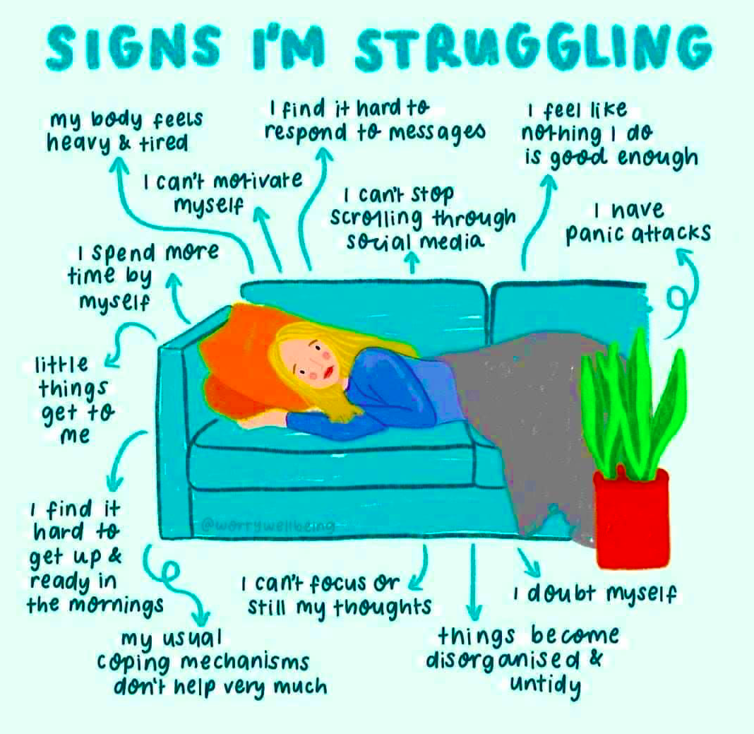
Impacts of the pandemic on mental health. Your results:
Your score is calculated as a sum of points from your answers (a range between 0 and 18 points).
If you receive at least 8 points, you might be experiencing symptoms of mild depression or anxiety.
Impacts of coronavirus pandemics on mental health. IDEA 2020.
DOPADY PANDEMIE KORONAVIRU NA DUŠEVNÍ ZDRAVÍ IDEA 2020
https://idea.cerge-ei.cz/vystupy/dopady-pandemie-koronaviru-na-dusevni-zdravi

Slide 10
What was your score?
ⓘ Start presenting to display the poll results on this slide.
Notes:
📣 This is Slido interaction slide, please don't delete it. ✅ Click on 'Present with Slido' and the poll will launch automatically when you get to this slide.

Slide 11
What would you advise to depressed or anxious person?
ⓘ Start presenting to display the poll results on this slide.
Notes:
📣 This is Slido interaction slide, please don't delete it. ✅ Click on 'Present with Slido' and the poll will launch automatically when you get to this slide.

Slide 12
Coping with the pandemic at the dormitories - quality of mobility in pandemic
In spring 2020 IRO staff have conducted survey at our dormitories, the main focus was “how students cope with the pandemic and whether they are needing our help”.
Nearly 200 hundred students answered our questions, meaning there was just a minority at the dormitory who did not reply.
Even without reading their answers we knew that they answered, because they needed to get in touch with “outer worlds”

Slide 13
What made you happy in the last couple of days
Nothing;
Netflix;
My friends;
That I found some friends in the supermarket;
Reading books;
My life; Nothing,
I had a good sleep :);
Do sport and Yoga, and talk with my friends; Exercise;
The reduced number of cases in the world;
The possibility of the semester to end in august (because at least we could enjoy our erasmus here after this health emergency situation);

Slide 14
What made you happy in the last couple of days
shopping online
To just go out for a small walk. After Quarantine day 3 I started crying.
my cat
My own space
The opportunity that I could spend more time with my family.
I got a part time job (I am hoping to start in May). Skyping with relatives and friends.
Having time for myself
Playing video games
Family
Eating and dreaming to go outside
Games
Nice weather and flowering plants
The sun, talking with friends, cooking, reading, having a clean flat after I cleaned it

Slide 15
And what have you missed most during pandemic?
ⓘ Start presenting to display the poll results on this slide.
Notes:
📣 This is Slido interaction slide, please don't delete it. ✅ Click on 'Present with Slido' and the poll will launch automatically when you get to this slide.

Slide 16
What percentage of students felt happy in spite of the pandemic?
ⓘ Start presenting to display the poll results on this slide.
Notes:
📣 This is Slido interaction slide, please don't delete it. ✅ Click on 'Present with Slido' and the poll will launch automatically when you get to this slide.

Slide 17
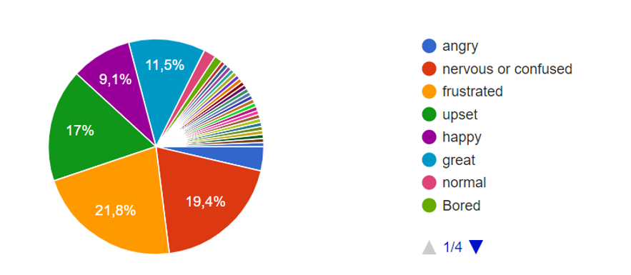
“How are you feeling these days?”

Slide 18
What were two main reasons for students to stay on Erasmus+ mobility and not return to home country?
ⓘ Start presenting to display the poll results on this slide.
Notes:
📣 This is Slido interaction slide, please don't delete it. ✅ Click on 'Present with Slido' and the poll will launch automatically when you get to this slide.

Slide 19
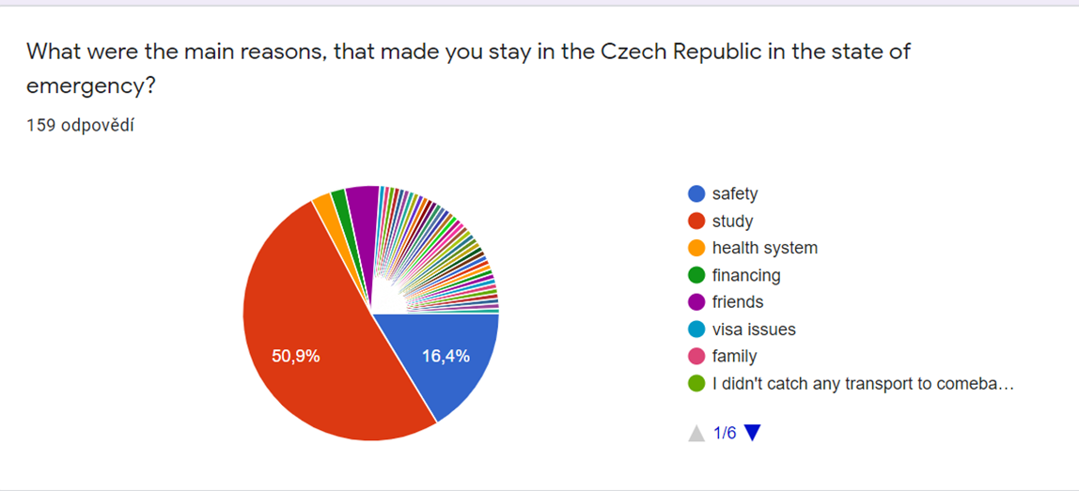
Reasons to stay on Erasmus during the first wave

Slide 20
How many percent of students have, in your opinion, refused any additional extracurricular activities from the university?
ⓘ Start presenting to display the poll results on this slide.
Notes:
📣 This is Slido interaction slide, please don't delete it. ✅ Click on 'Present with Slido' and the poll will launch automatically when you get to this slide.
zaměstnání, sporné, znesnadňuje porozumění

Slide 21
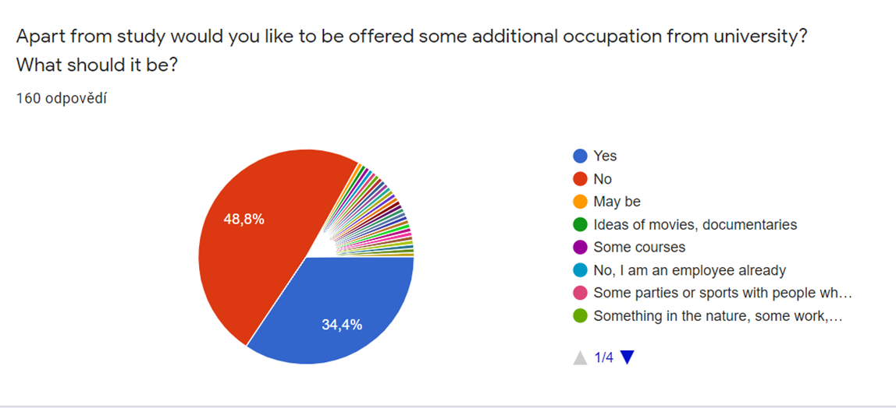

Slide 22
“All progress takes place outside the comfort zone.” Michael John Bobak
“Coming on Erasmus while covid is just outside the window may not be the easiest choice to make. Luckily enough I decided to come despite everything and there is nothing to be feared of!”
“Actually I could even say that this Erasmus, even considering the covid thing, was one of the best semesters of my life, and for sure it was the most unpredictable!”
“Universities, one by one started to close, places that once were full of life began emptying, and people who once used to stand in line to get Galão were now standing in a long line to buy a hand sanitiser.”

Slide 23
Opportunities in student mobilities, that pandemic revealed to us:
ⓘ Start presenting to display the poll results on this slide.
Notes:
📣 This is Slido interaction slide, please don't delete it. ✅ Click on 'Present with Slido' and the poll will launch automatically when you get to this slide.

Slide 24
Your slogan for mobilities after the pandemic:
ⓘ Start presenting to display the poll results on this slide.
Notes:
📣 This is Slido interaction slide, please don't delete it. ✅ Click on 'Present with Slido' and the poll will launch automatically when you get to this slide.

Slide 25
I believe we will get through this and come out of it stronger in spirit.

